Slide 1

Cruz Roja Tijuana
Final Presentation

Slide 2
Problem
Cruz Roja in Tijuana only has 8 ambulances and emergency response times are unreasonably long
Information collected from the patient by the EMTs are often collected again by nurses and time is wasted

Slide 3
Project Goals
Produce an easy-to-use interface that displays areas most likely to need emergency medical attention based on historic data
Optimize the ambulance procedure using historic data
Data storage system so that all Red Cross can access and update the same information for each patient

Slide 4
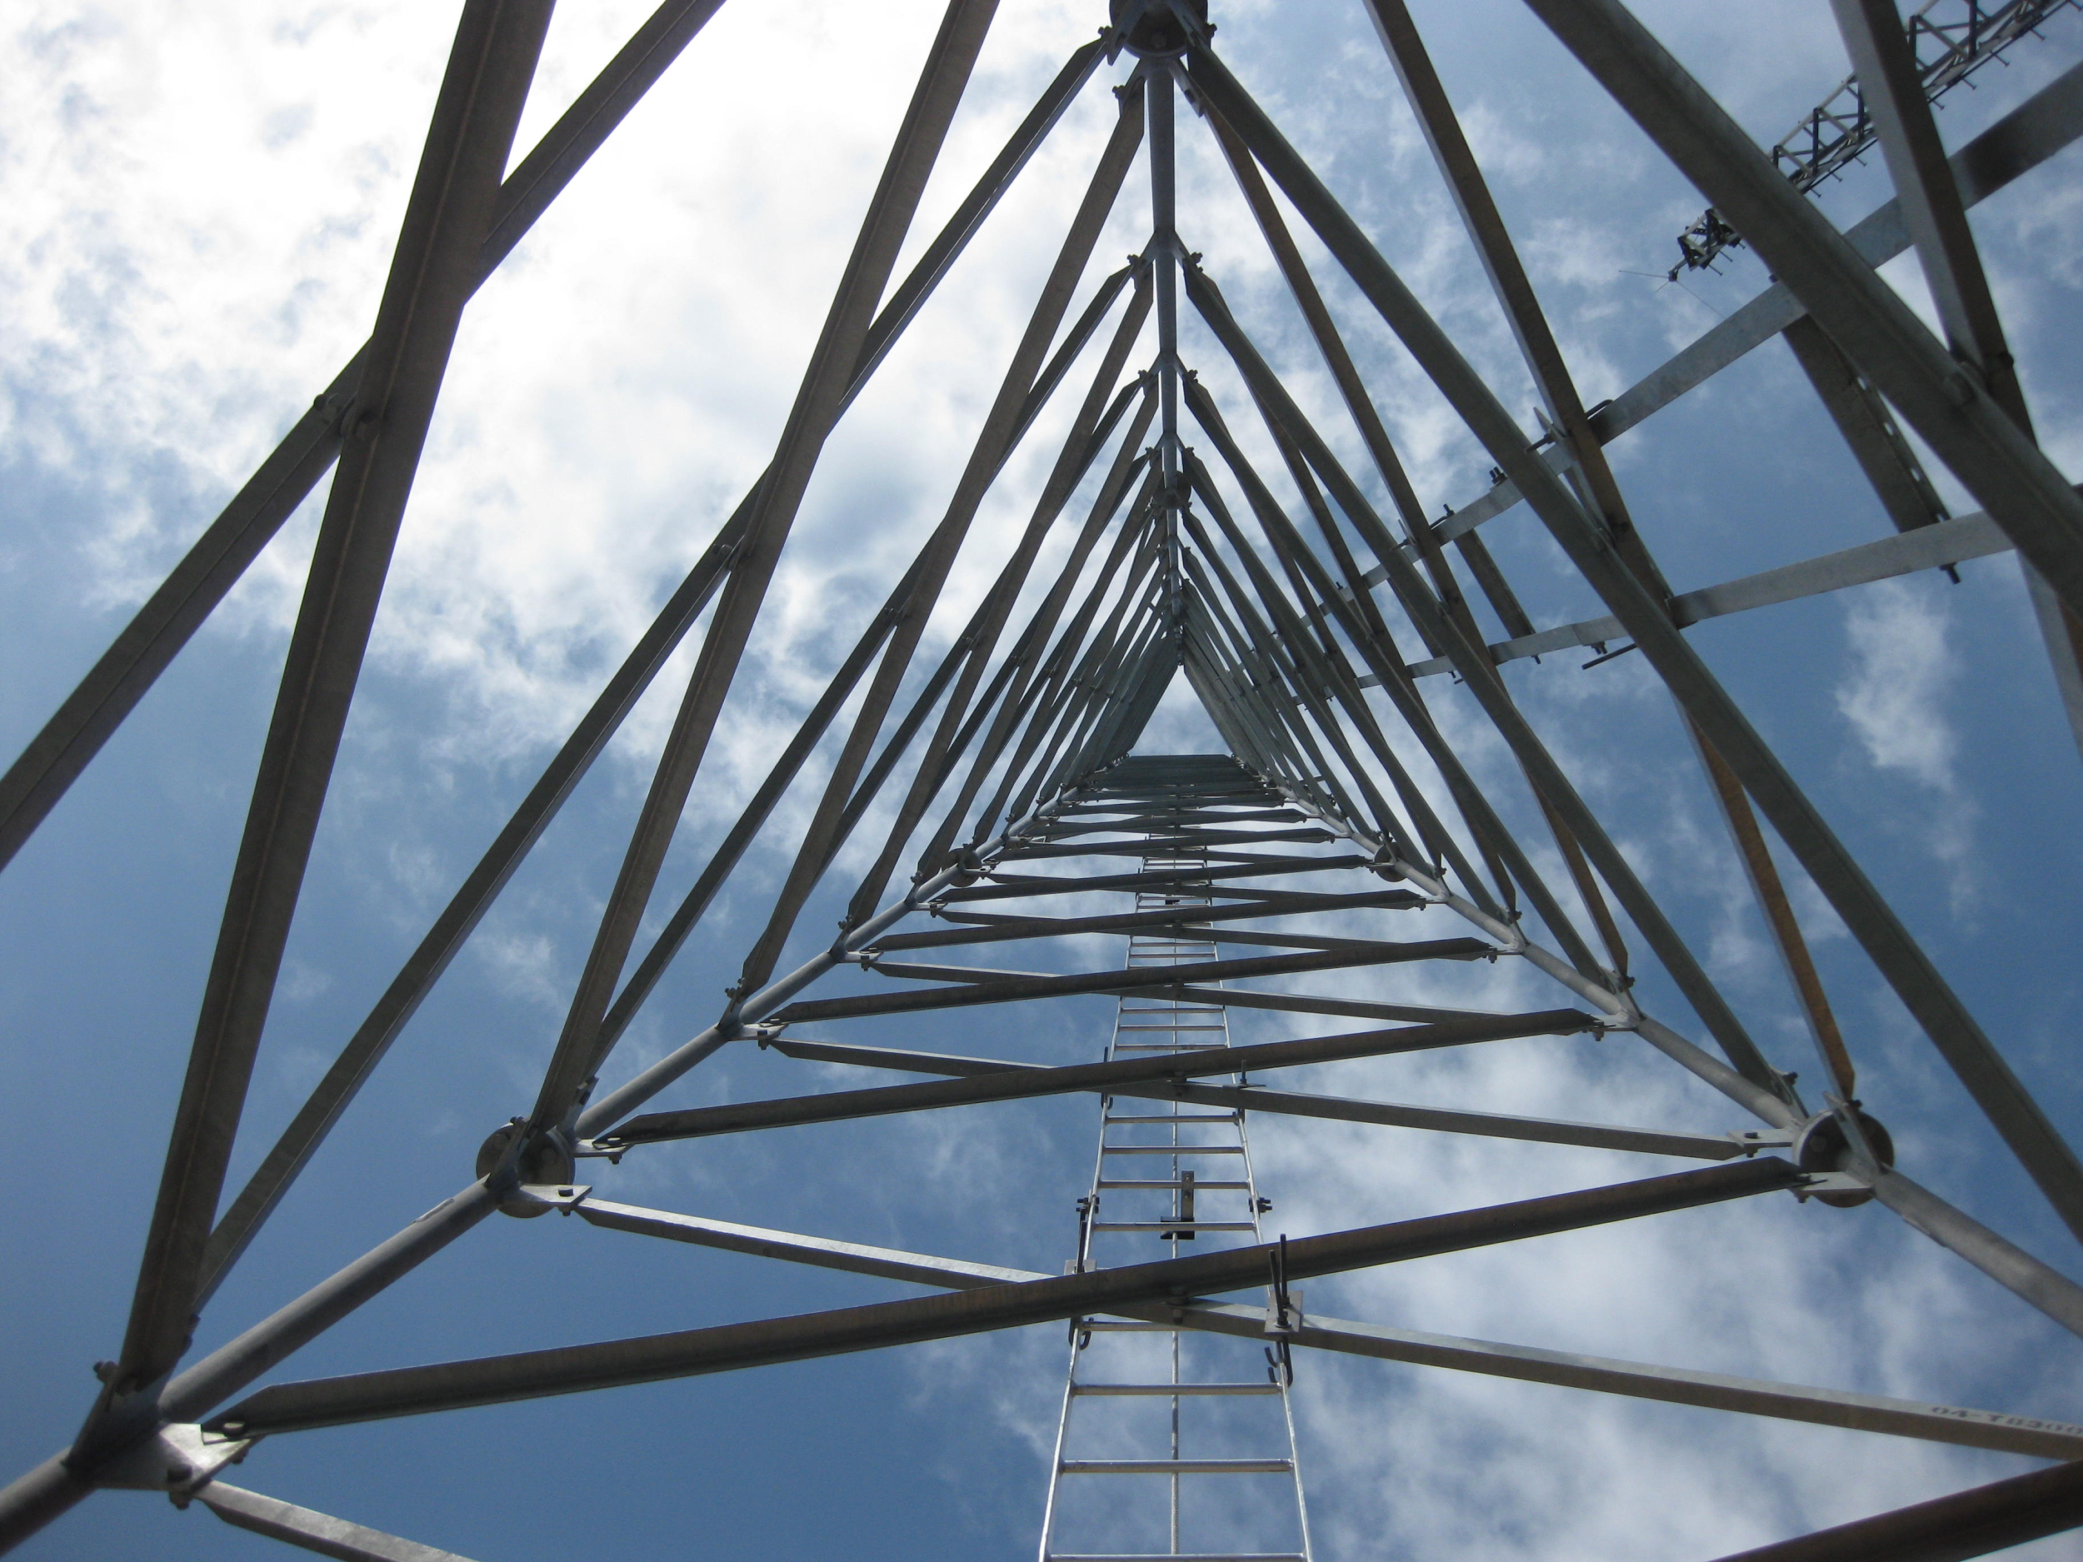
Team Structure
AED Web App
Ambulance Web App
Ambulance Location Mobile Team

Slide 5
Quarter Goals
AED team: Add features to the existing web application skeleton
Mobile App team: Started new app that communicates with database
Ambulance App team: Display ambulance locations on map

Slide 6
Inventory - Software
Git repository git@cruzroja.ucsd.edu
Server hosted on ucsd.edu

Slide 7
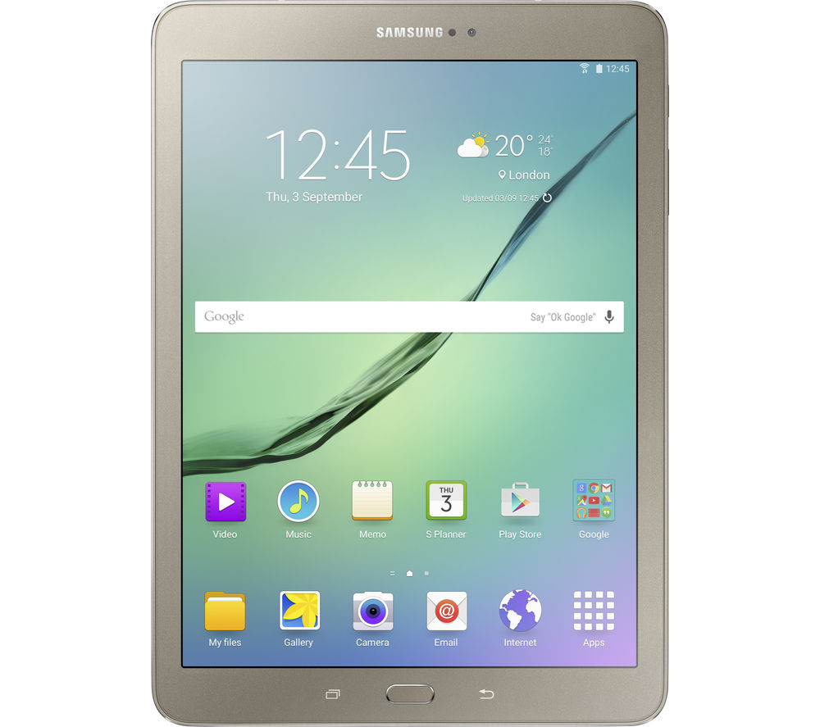
Inventory - Hardware
Test tablet
Samsung Galaxy Tab A 8.0 (T-Mobile)
Android 5.0 Lollipop
GPS enabled
4G LTE
5MP Camera
2MP Front facing camera
Bluetooth
Can be donated to Cruz Roja in the future

Slide 8

AED Subteam
Objectives:
Build user authentication
Add support for pictures for each listed AED
Provide the information in Spanish

Slide 9
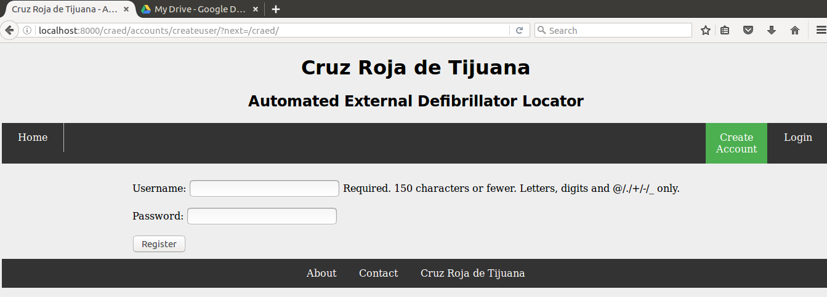
AED: User Authentication

Slide 10
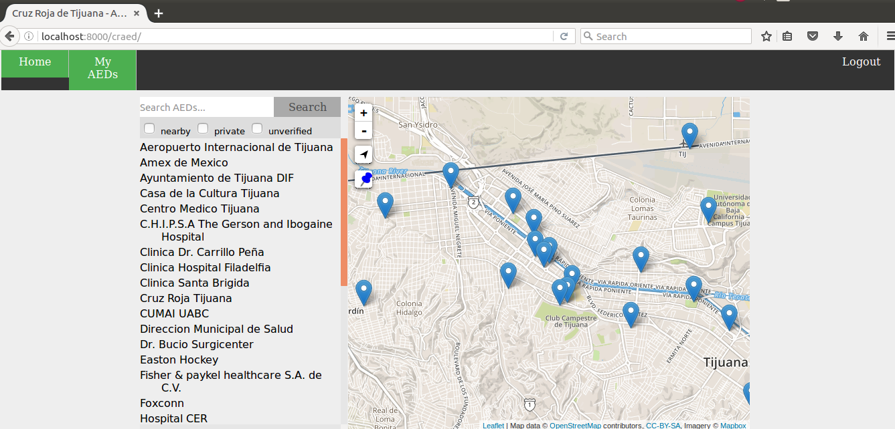

Slide 11
AED: Uploading Photos
Uses ImageField, a wrapper for UploadedFile
Requires framework Pillow, a fork of PIL (Python Imaging Library)
Using Pillow has added benefit of being able to resize images dynamically
Image Fit (https://github.com/vinyll/django-imagefit)
Another good option for dynamic image resizing for thumbnails

Slide 12

AED: Spanish Translation
Goal: Goal was not reached.

Slide 13
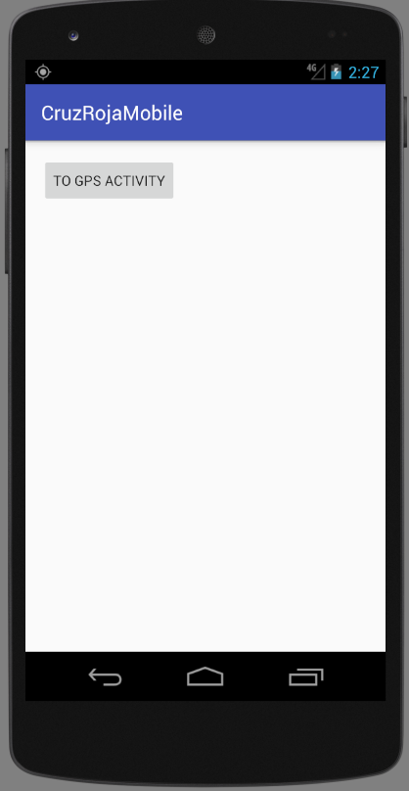
Ambulance Mobile App Team
Goal: To create a mobile application for ambulance drivers in Tijuana, to enhance communication between ambulance drivers and those who require emergency services.
Notes:
We are..mobile app subteam. Primary goal move on in a different direction from last year from a mobile web app and into a native Android application optimized for phones.
Purpose was to enhance the communication between ambulance drivers and those who require emergency services.

Slide 14
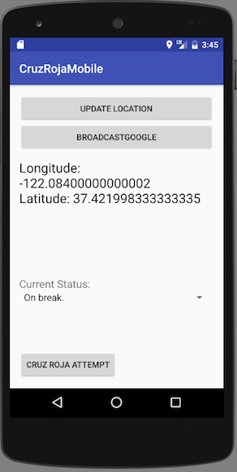
Mobile App: Main Functionality
Get and Display Current Location
Choose Status Update
Transmit Collected Data to Database
Notes:
Maria
Black Box description, answers “What does this app do?” for the ambulance driver

Slide 15
Mobile App: Current State
Invokes location functions to get the longitude and latitude.
Ambulance drivers can choose their current status.
Box the location information with the status and the time when the location was grabbed into a package.
The app transmits the packaged information to the database.
Notes:
Speaker: Maria
Clear Box description, for the under-the-hood description of what the code is doing

Slide 16
Mobile App: Tools of the trade
Developing for native mobile client (Android)
Android Studio
Android built-in APIs
Java: the implementation of our functions
Analogy: the engine, gas injection, power steering, circuitry
XML: the implementation of our visuals (buttons and menus)
The gas pedal, the brakes, the steering wheel
Notes:
Used Android Studio (IDE) as the command center of the app building. From this, we used built in APIs, and Java to write our code. XML itself is the structure of our application and code.

Slide 17
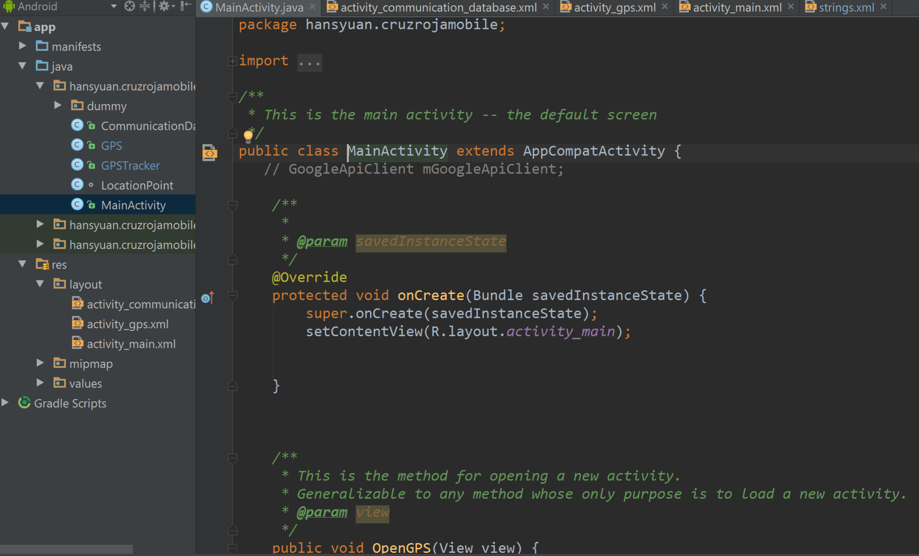
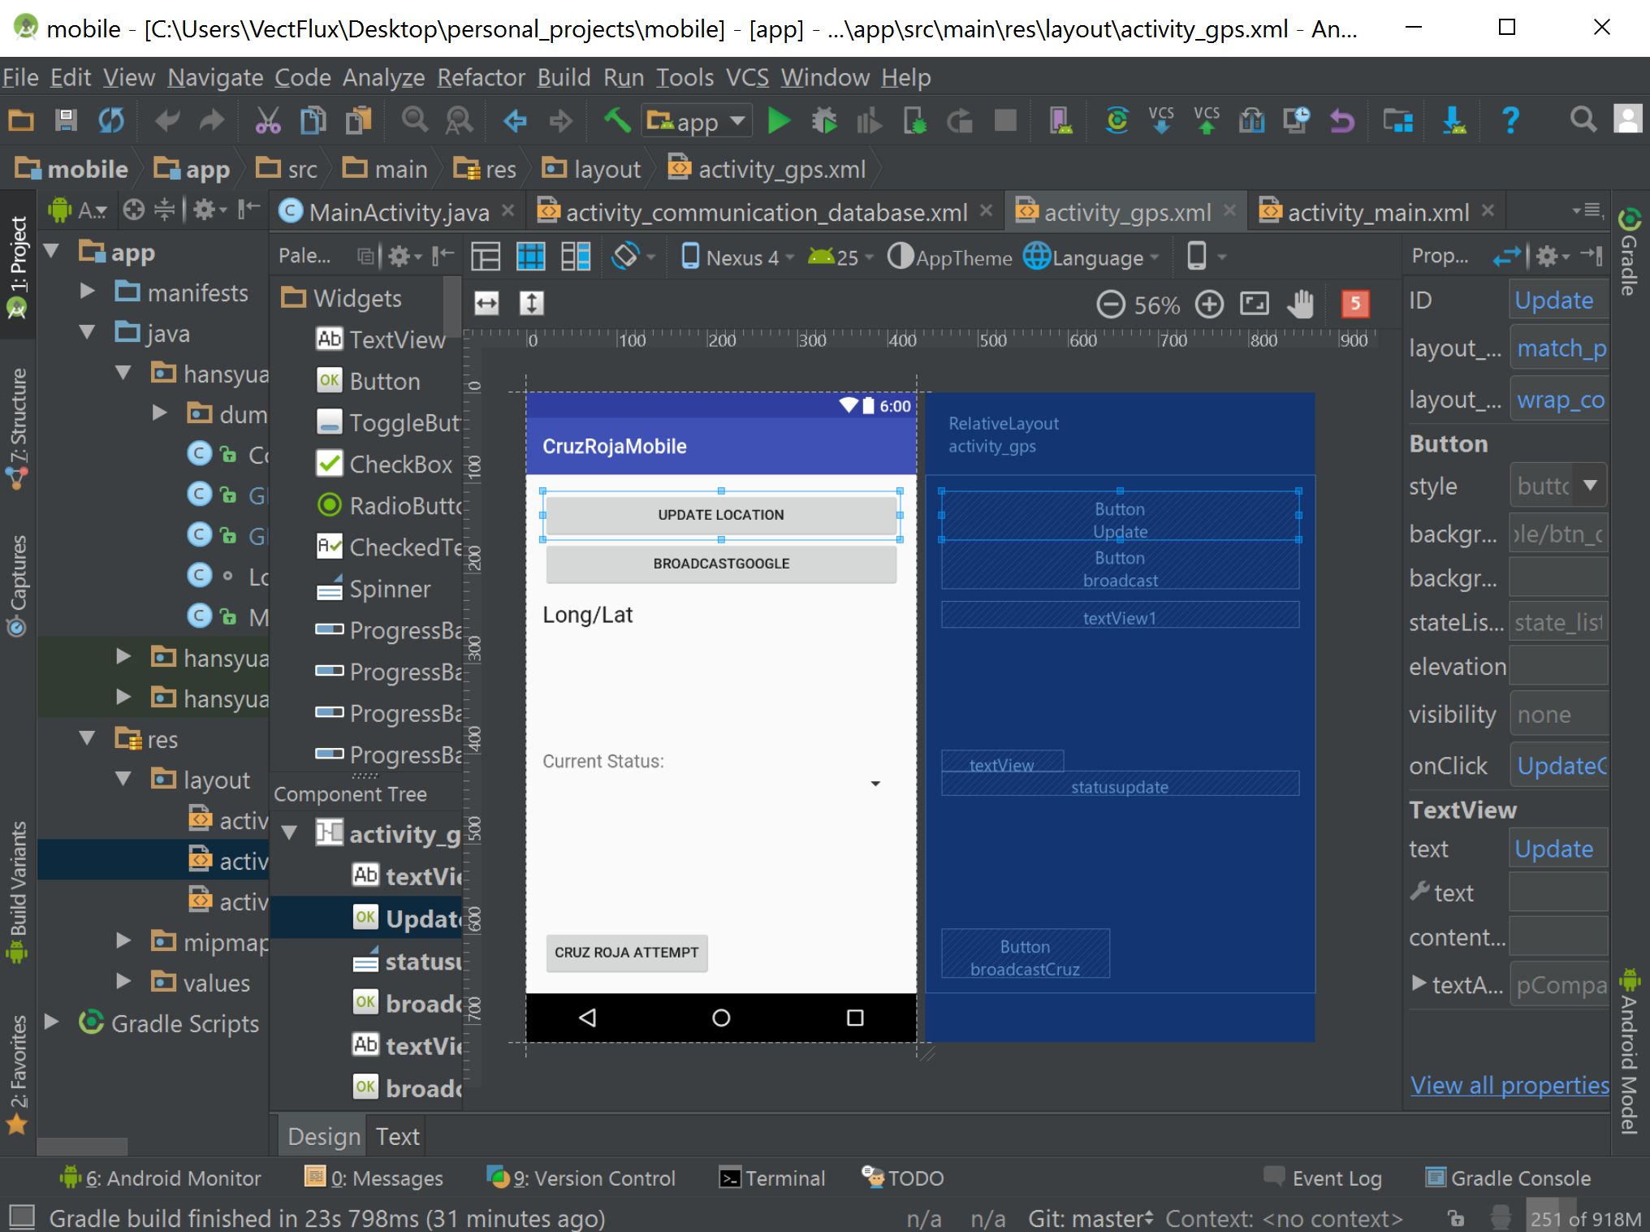
Notes:
Left side of Android Studio shows our file directory and layout with our files.
When clicked on, will open up the window with the Java code
XML can also be edited in the same window, when that occurs, the change in the layout will be shown on the right

Slide 18
Mobile App: Process
Started a new Android project.
Many of the desired functions do not need to be recreated. They just need to be invoked.
Much of the code to invoke the functions for locations, permissions, and internet access are available online.
After the code is completed, Android Studio generates the app, which is then downloaded into the phone or emulator.
The phone can then use the app.
Notes:
manny
Intent: general process of developing an Android app

Slide 19
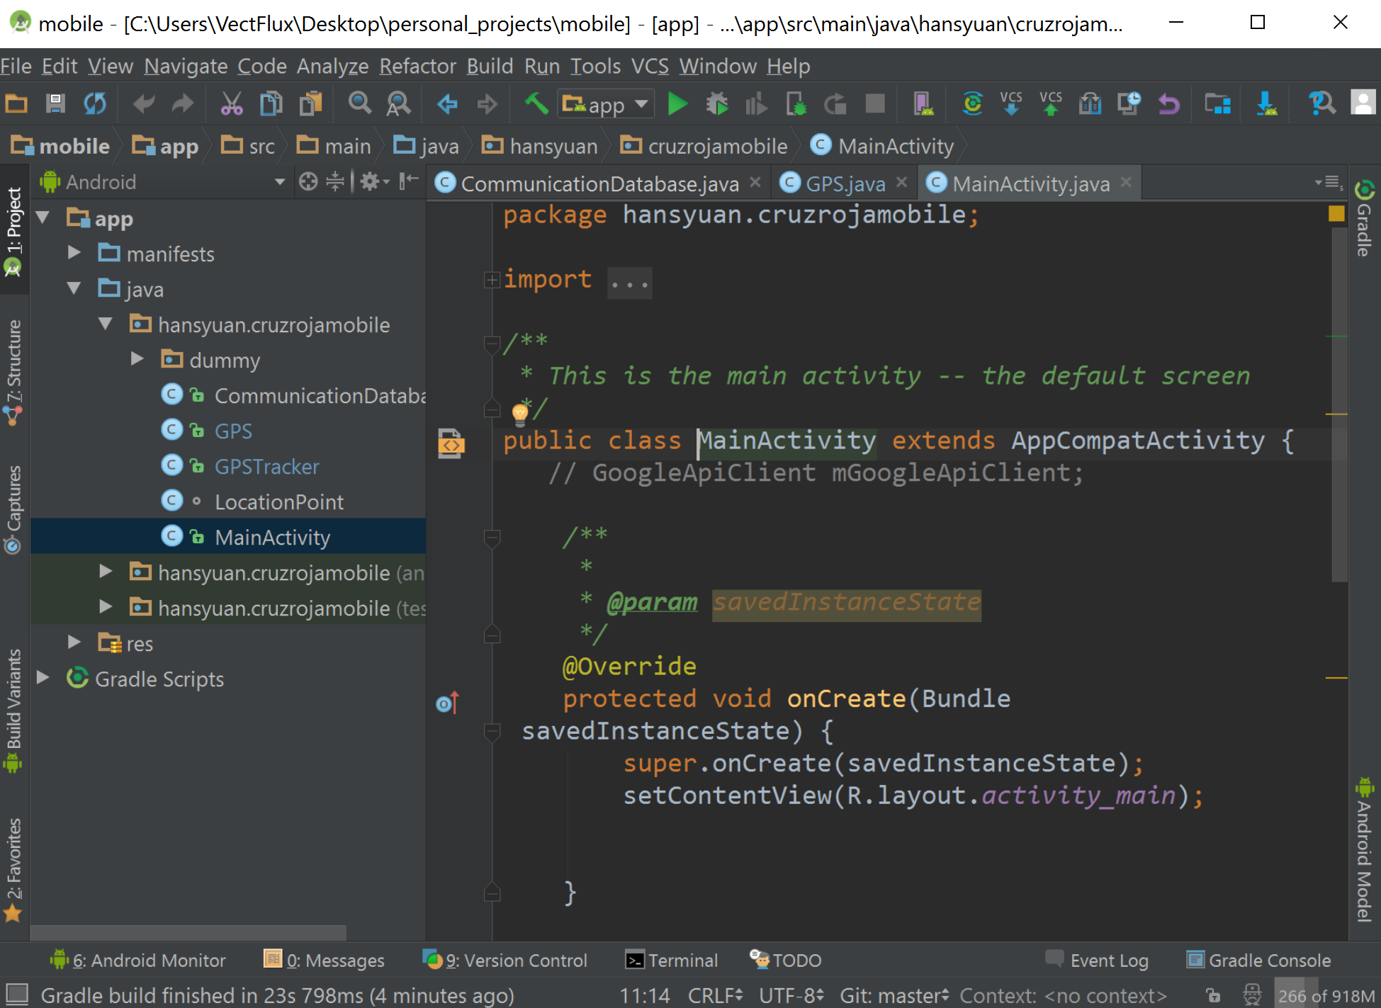
Notes:
replace with xml files open

Slide 21
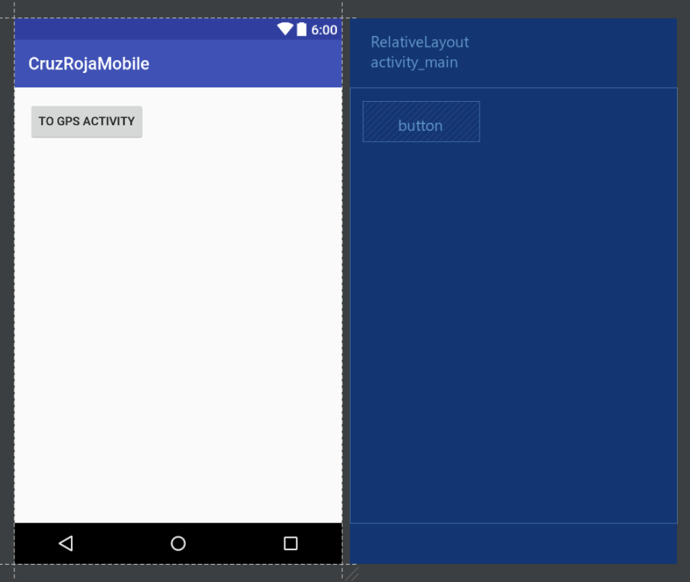
Mobile App: Development
This is the first screen seen when fresh starting the app.
The button is linked the its respective Java function, which just initiates the GPS Activity.
Notes:
Speaker: Hans
Intent: To talk about the process of how we designed our app.

Slide 22
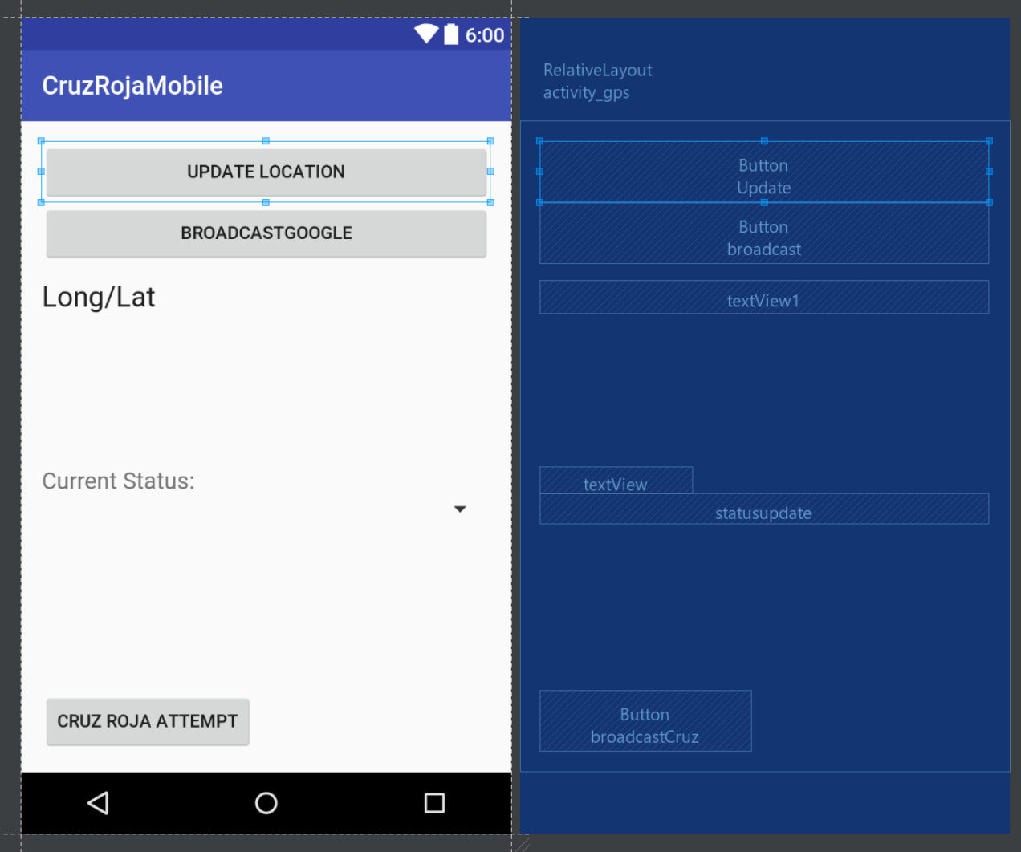
Mobile App: Development
The core of the app
The UpdateLocation button invokes its respective Java function, which grabs the current location.
Notes:
Speaker: Hans
Intent: To talk about the process of how we designed our app.

Slide 23
Mobile App: Development
GPS Activity:
The “Cruz Roja Attempt” button is linked to the Java function, which does the following:
boxes the location and status into a packaged URL
indirectly transmits the package to the database by calling a URL.
Notes:
Speaker: Hans
Intent: To talk about the process of how we designed our app.

Slide 24
Mobile App: Development
Normally, URLs are just used for getting on webpages.
URLs initiate initial contact with the server before receiving the webpage.
The packaged information is stored inside the URL within the initial contact to transfer the information.
Notes:
Speaker: Hans
Intent: To talk about the process of how we designed our app.

Slide 25
Mobile App: Future Goals
Simplify the app interface. Require as little work as technically possible so that drivers don’t have to spend much thought using this.
Do transmission of data as background process or automatic process.
Implement user login.
Sync collected data to the server once every few seconds.
Let other drivers view information about all ambulance drivers.
Add Google Maps to display driver’s location.
Implement iOS version of the app.
Notes:
Manny
Transitions to the web app display team

Slide 26
Ambulance Web Application Subteam
Objective: Create a unified platform for ambulance response teams to view and update ambulance information in real-time.

Slide 27
Ambulance Web Application: Features
Interactive map with real-time ambulance locations
Database containing ambulance information (location, status, reporter, plate number)
Ability to add ambulances
Ability to add reporters
Request handling to update ambulance information remotely
Secure access of ambulance information

Slide 28
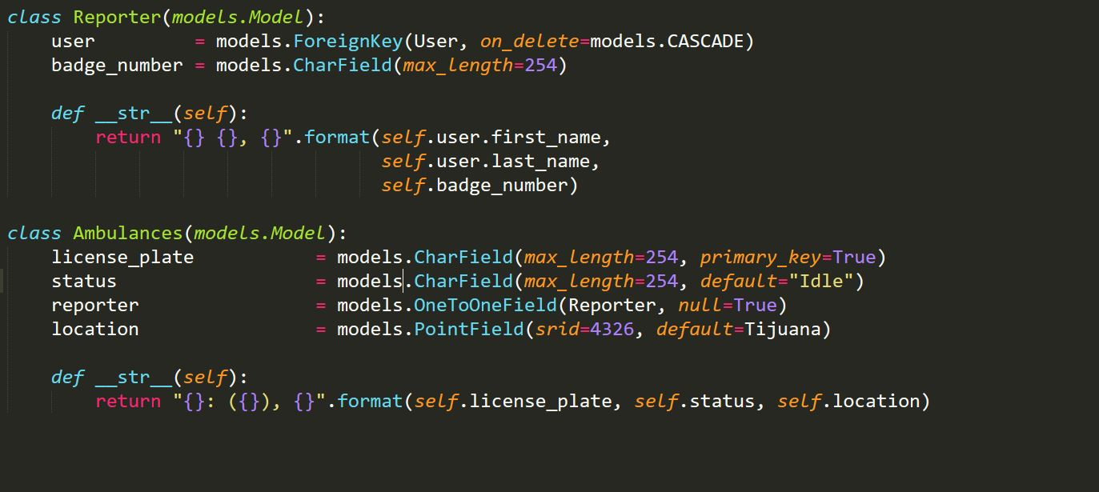
Ambulance Web App: Keeping Track
A table for reporters
A table for ambulances

Slide 29
Ambulance Web App: Talking to Other Devices
Sending information
Requesting information
Ensure security
Example: Requesting Ambulance information

Slide 30
Ambulance Web App: HTTP Requests
“https://cruzroja.ucsd.edu/ambulances/info/123456”
A destination (general)
“https://cruzroja.ucsd.edu/ambulances”
A command (unique)
“/info/123456”

Slide 31
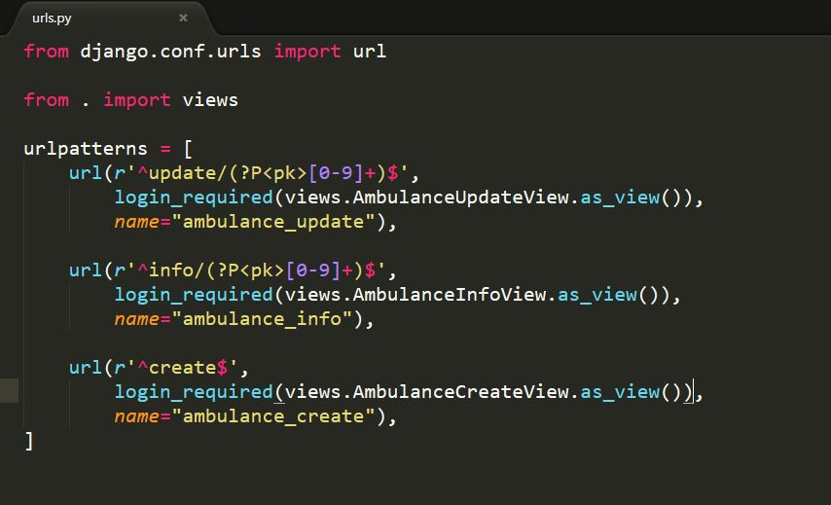
Ambulance Web App: HTTP Requests
The project will figure out what to do with the URL and give the appropriate response
https://cruzroja.ucsd.edu/ambulances/info/123456

Slide 32
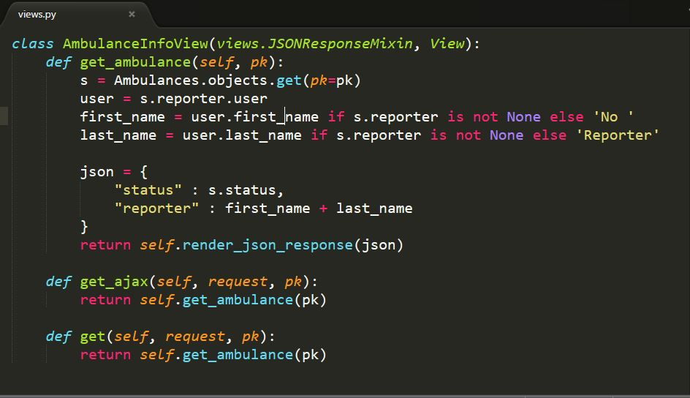
Ambulance Web App: HTTP Requests
The “info” view will find the right ambulance, build a json object, and then display it
https://cruzroja.ucsd.edu/ambulances/info/123456

Slide 33
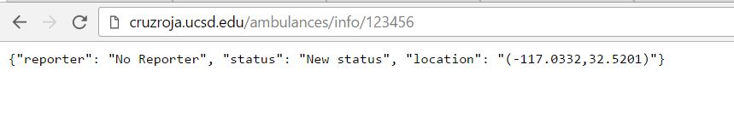
Ambulance Web App: HTTP Requests
The “info” view will find the right ambulance, build a json object, and then display it
https://cruzroja.ucsd.edu/ambulances/info/123456

Slide 34
Ambulance Web App: Templates
Webpage HTML uses Django templates
Base template initializes the map as the background and an overlay
Additional functionality can easily be implemented by extending the base template
Ambulances_list.html adds the ambulance list and markers to the page

Slide 35
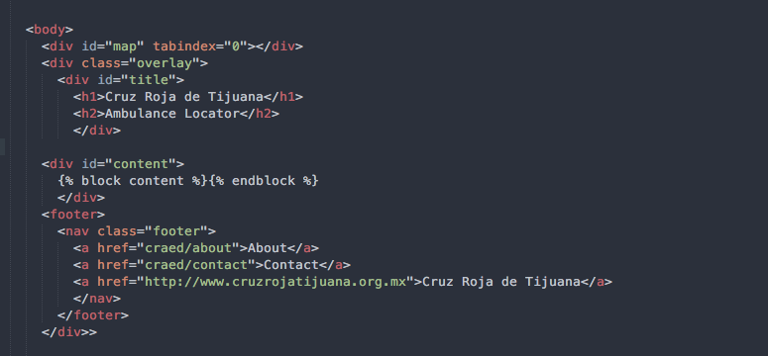
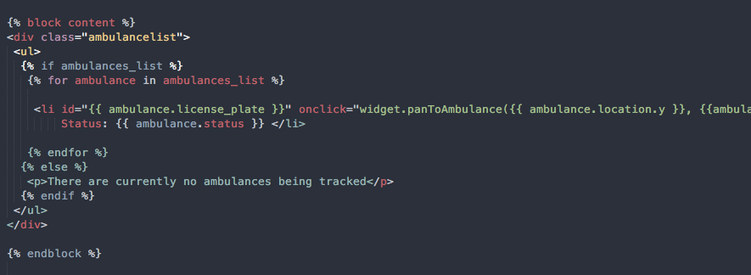
Ambulance Web App: Templates
Ambulance_base.html (base template file)
Ambulances_list.html (extends base template)

Slide 36
Ambulance Web App: Leaflet Map
We use Leaflet, a Javascript library for interactive maps
Map functionality is kept in leaflet_map javascript file
Create map with desired initial settings
Add/update markers on map
Use custom ambulance marker
Center map view on specific marker
Popup functionality

Slide 37
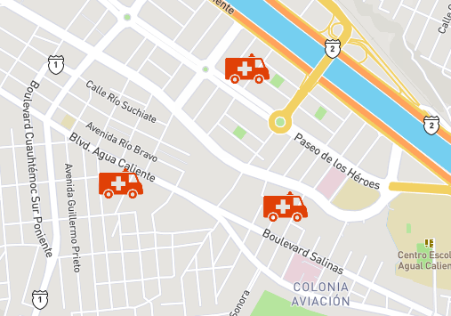
Ambulance Web App: Real-Time Locations
Uses location data from database to place markers on the map
Call from database every few seconds to keep ambulance information current. Marker locations are updated without having to refresh page

Slide 38
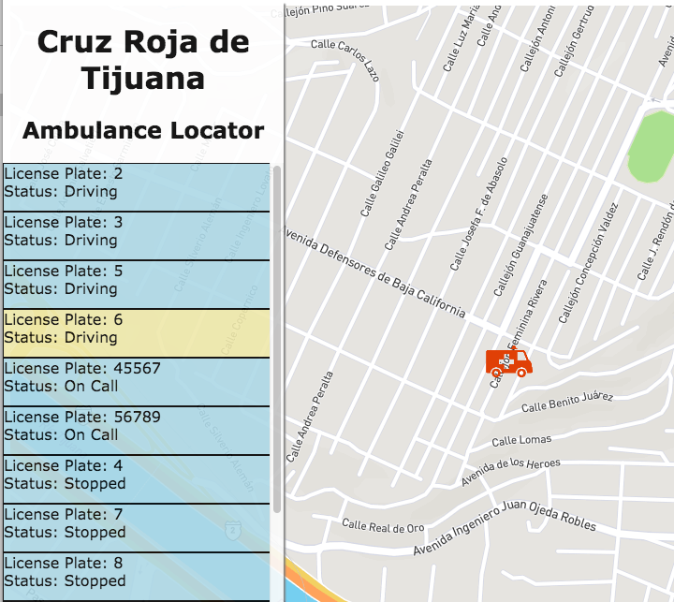
Ambulance Web App: Ambulance List
Scrollable list of ambulances from database
Displays license plate number and status of vehicle
Clicking on list item centers map on ambulance’s marker

Slide 39
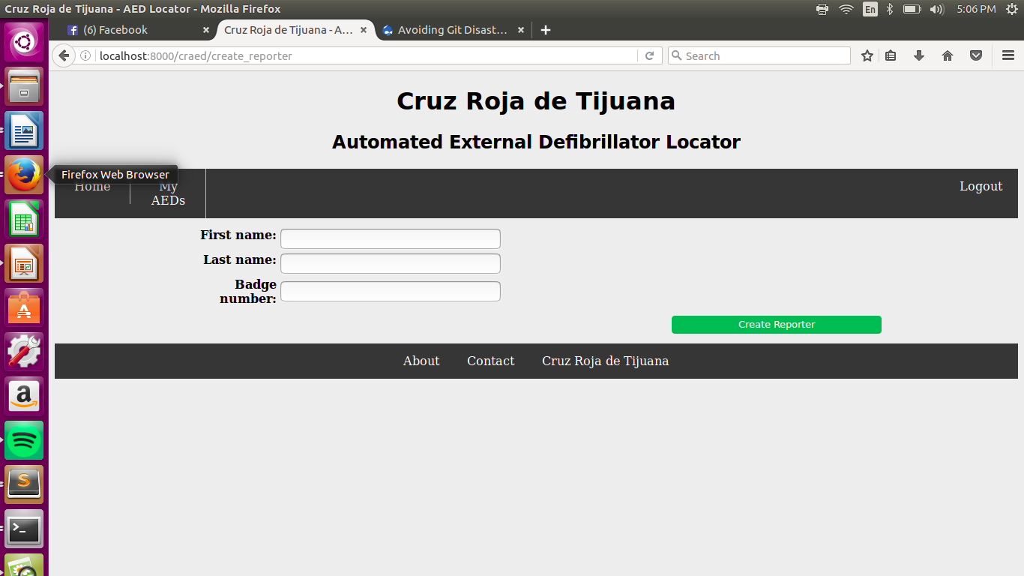
Ambulance Web App: Forms
User can input in data for a Reporter
Reporter automatically put into database
Can retrieve Reporter information through any of the fields

Slide 40
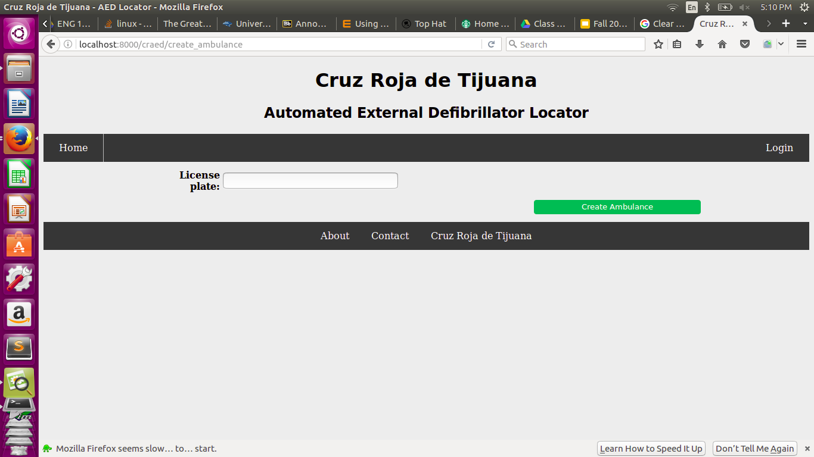
Ambulance Web App: Forms
User can input data for an ambulance
Ambulance automatically put into database
Can retrieve Ambulance info and update ambulance info using license plate

Slide 41
Ambulance Web App: Future Goals
Improve map view
Solidify pop-up functionality
Collect and monitor ambulance use frequency, hot spots, and routes

Slide 42
AED: Future Goals
Display the photos of AED
Scaling photos into thumbnails
Develop some backend work to direct users to nearest AED
Complete support for Spanish

Slide 43
Acknowledgements
Thank you Cruz Roja for the opportunity to work on a real and useful project
Thank you Professor Mauricio de Oliveria and Gabri for your supportive guidance throughout the quarter

